Slide 1
Pre Sales, Delivery and MSI Ways of Working
June 2017. Version 2.0

Slide 2
Pre Sales Ways of Working – Key Highlights
Bid Director contacts MSI ITO lead who assign a MSI SPOC for the deal term
Bid Director Involves ITAS for deals over 100 Mil
Bid Director will involve PMO Delivery SPOC as and when required
Considered deals greater than 10 Mil
Suitable for both NN and EN deals
Suitable for only Service Transition and / or Transformation Deals
Consulting Ways of Working not included in this

Slide 3
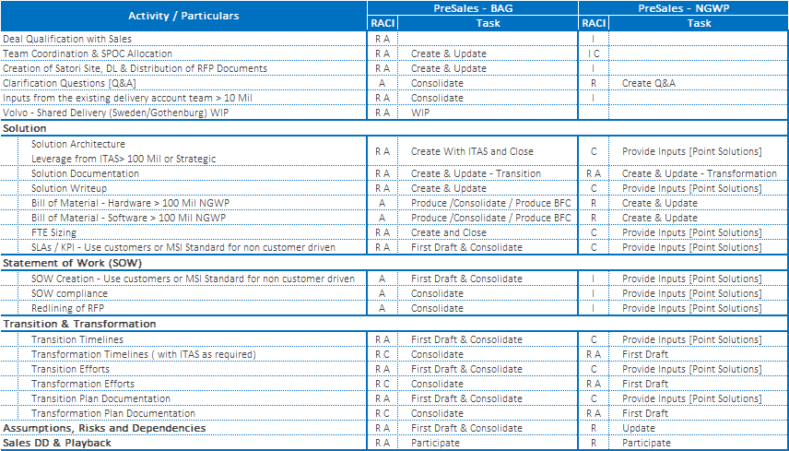
Pre Sales Ways of Working – BAG and NGWP Teams

Slide 4
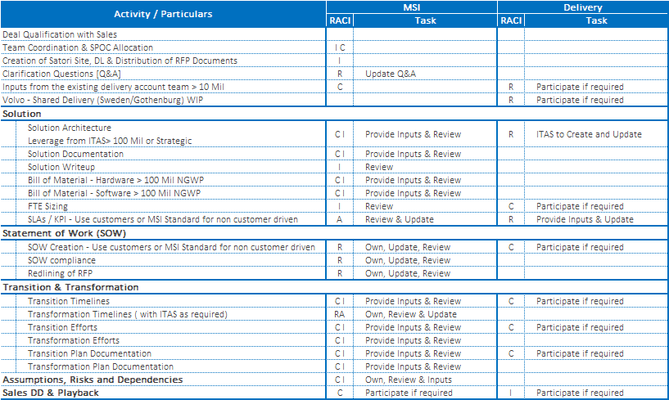
Pre Sales Ways of Working – MSI, Delivery Teams

Slide 5
BAG, Pre Sales, MSI & Delivery Interconnects
Deal Qualification
Team Coordination & SPOC Allocation
Creation of Satori Site, DL & Distribution of RFP Documents
Clarification Questions [Q&A]
Inputs from the existing delivery account team > 10 Mil
Sales DD & Playback
BAG
Pre Sales
MS I
De l I ver y
Solution
Solution Architecture Leverage from ITAS> 100 Mil / Strategic
Solution Write-up
Bill of Material – HW / SW > 100 Mil NGWP
FTE Sizing
SLAs / KPI
Create Solutions
Update Solution Components
Consolidate Solution
Review and Provide Feedback
SOW
Use customers or MSI Standard for non customer driven
SOW compliance
Redlining of RFP
Transition & Transformation
Transformation Timelines ( with ITAS as required)
Transition & Transformation Efforts
Transition & Transformation Plan Documentation
Assumptions, Risks and Dependencies

Slide 6
Abbreviations
BAG | Business Acquisition Group
NGWP | Next Generation Work Place
MSI | Migrations and Systems Integration
ITAS | IT Architects Services
SOW | Statement of Work
DD | Due Diligence
DL | Distribution List
WIP | Work in Progress
SPOC | Single Point Of Contact

